Slide 1

Babak Emami,
Senior Data Scientist / AI Architecture
Emami.Babak@gmail.com
647-326-6199

Slide 2
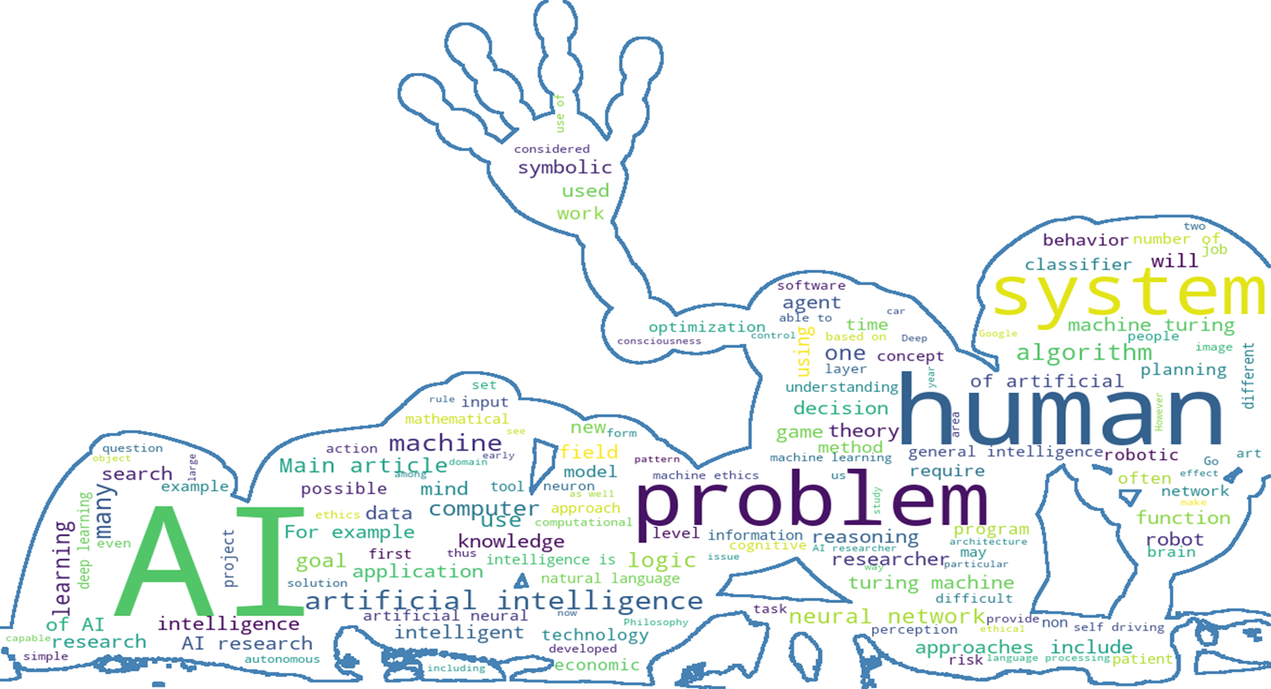
New York Green Taxi Hourly Base Behavior Analysis (POC)

Slide 3
Agenda
Phase 1 - Read the raw data and add Pickup and drop off Zip-Code
Phase2 - Analysis the processed data and provide monthly, daily and hourly dashboard report
Phase3 - Time series forecasting for a 2016-Feb-12 between 10 :00 AM to 22: 00 PM
Phase4 - User pickup location recommender system

Slide 4

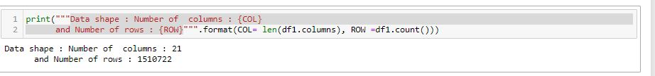
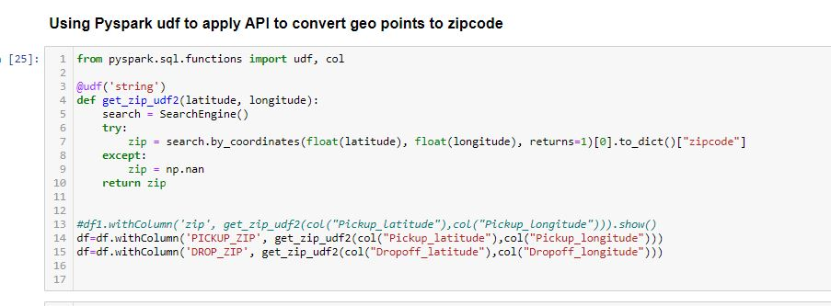
Phase 1 Read the raw data and add Pickup and drop off Zip-Code
Step 1: Load Data loading using Pyspark. Data shape ( 21 * 1510722)
Step 2: add map the given points to correspondent Network zip code using “uszipcode” open API

Slide 5
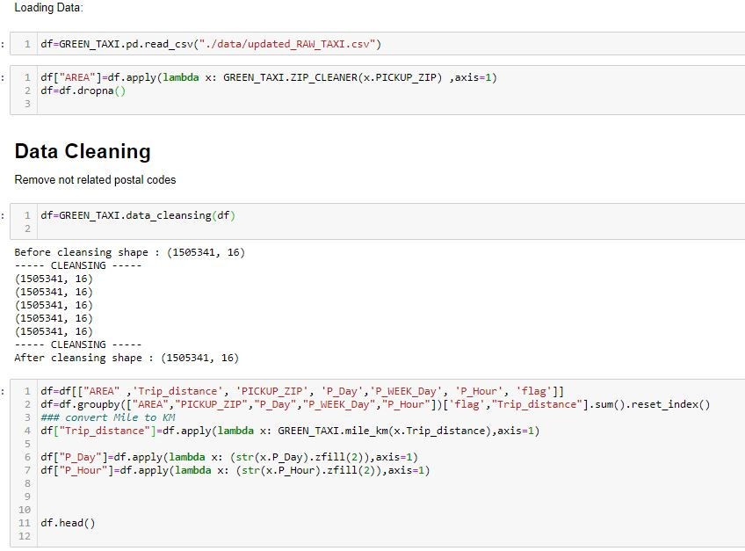
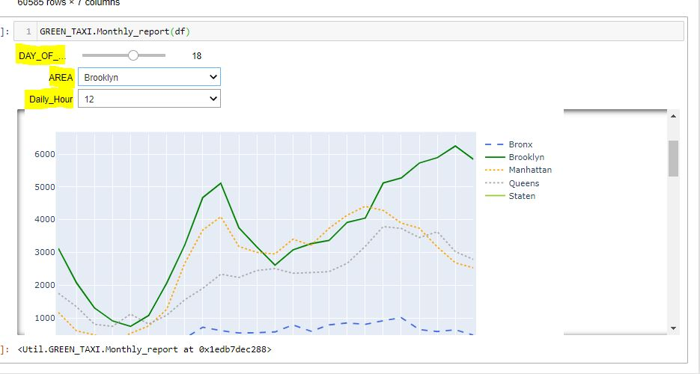
Phase 2 Analysis the processed data and provide monthly, daily and hourly dashboard report
Step 1:
Data cleaning and feature generation; adds postal code area like Manhattan, queens,..
Aggregate data on an Hourly basis for each zip code. Correspondent codes and implementation have been added as an external package name GREEN_TAXI.
Step 2:
Call the reporting function to access the interactive Plotly dashboard. The dashboard will update you with a 360 view to show what is happening per day/hour in each of which New York Area. It would compare the total distances/trips and max trips distance per given date.

Slide 6
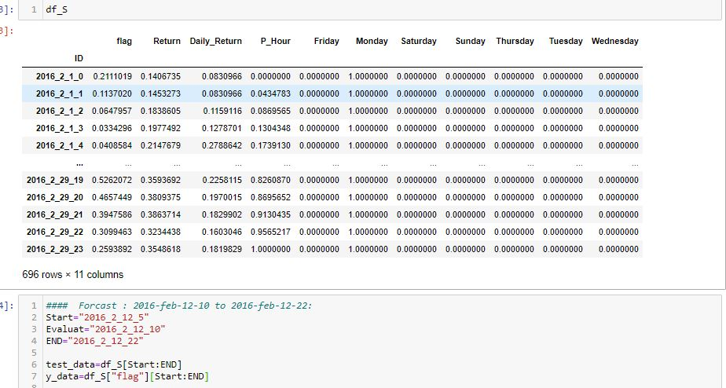
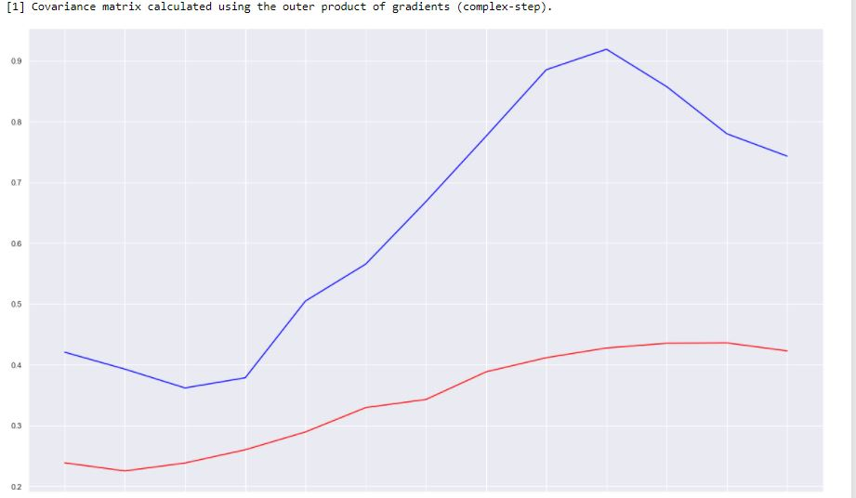
Phase3 Time Series Forecasting on Feb 12 from 10 Am to 10 PM
Step 1 Data preparation and feature generation
Step 2 Analysis using single variable (number of trips per hour) using auto Arima : Not efficient

Slide 7
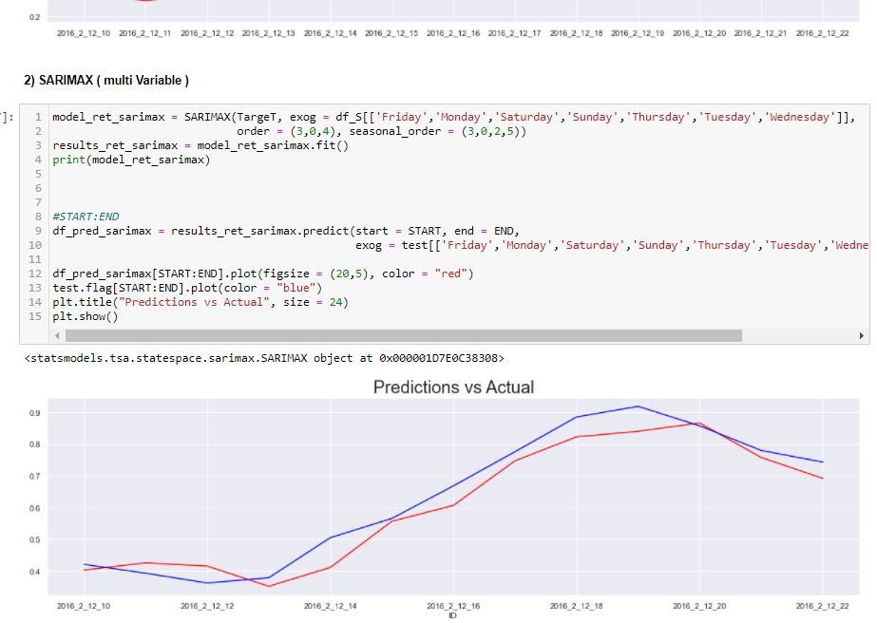
Phase 3 Time Series Forecasting on Feb 12 from 10 Am to 10 PM
Step 3 Analysis using Multi variable SARIMAX: efficient,
Step 4 Analysis using Multi variable auto Arima : Not efficient

Slide 8
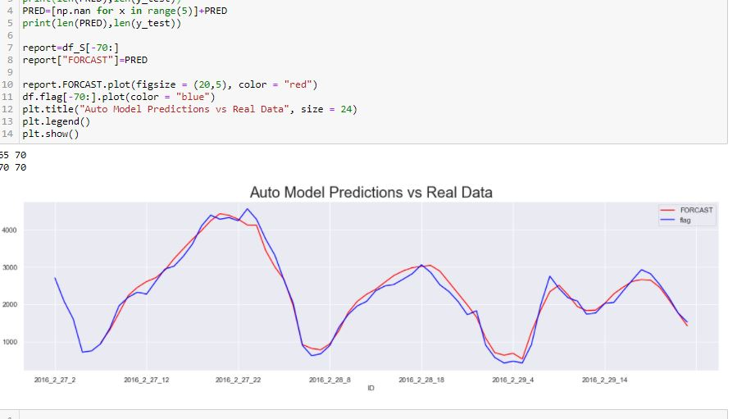
Phase 3 Time Series Forecasting on Feb 12 from 10 Am to 10 PM
Step 4 Analysis using Multi variable LSTM, very efficient. 95% accuracy R squared

Slide 9


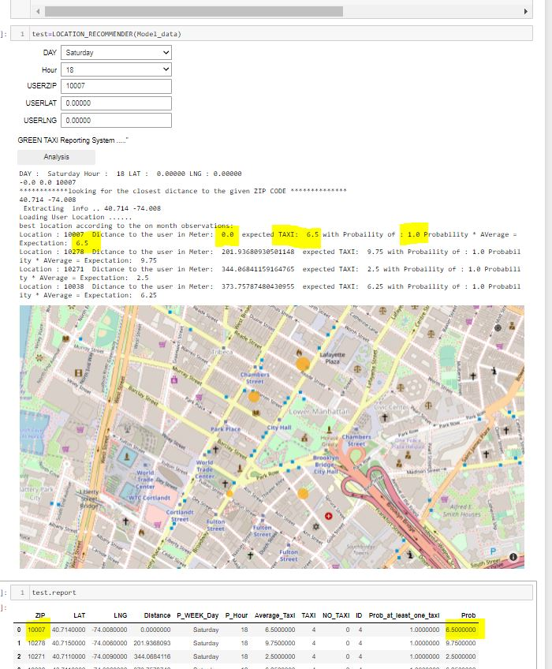
Phase 4 User pickup location recommender system
Using geographic points or postal codes, the model will reports the shortest distance using highest probability of seeing taxi

Slide 10

Thank you!

Slide 11
Requirements:
argparse
uszipcode
plotly
matplotlib
sklearn
tensorflow
ipywidgets
haversine
requests
scipy
statsmodels
pmdarima
seaborn
haversine
findspark
pyspark

